Slide 1


Lecture 2: Data Warehouse Concepts
Ali Chelli
Course: Business Intelligence and Data Warehousing (BID3000)

Slide 2
Outline
Basic Data Warehouse Concepts
Motivations and Characteristics
Data Warehouse Architectures
Employment Opportunities

Slide 3
Basic Data Warehouse Concepts

Slide 4
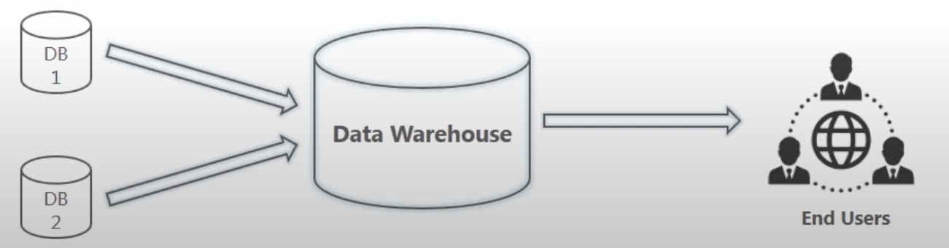
Business Intelligence and Data Warehouse
Business Intelligence (BI) is the act of transforming raw/operational data into insightful and actionable business information.
How Does BI Works?
BI systems collect information from several data sources (the company operational DBs).
This data is transformed (cleaned and integrated) and loaded into a Data Warehouse.
Since the data in DW is credible, it is used for business insights.

Slide 5
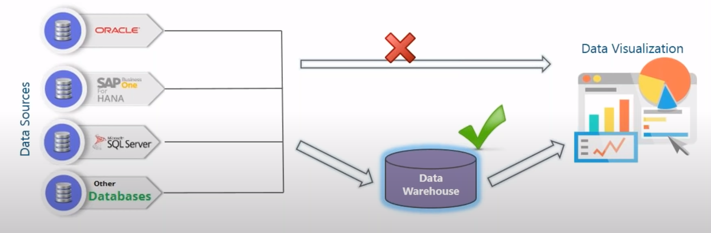
Why a Data Warehouse?
Data collected from heterogenous sources cannot be directly visualized.
The data first needs to be integrated and then processed before visualization takes place.

Slide 6
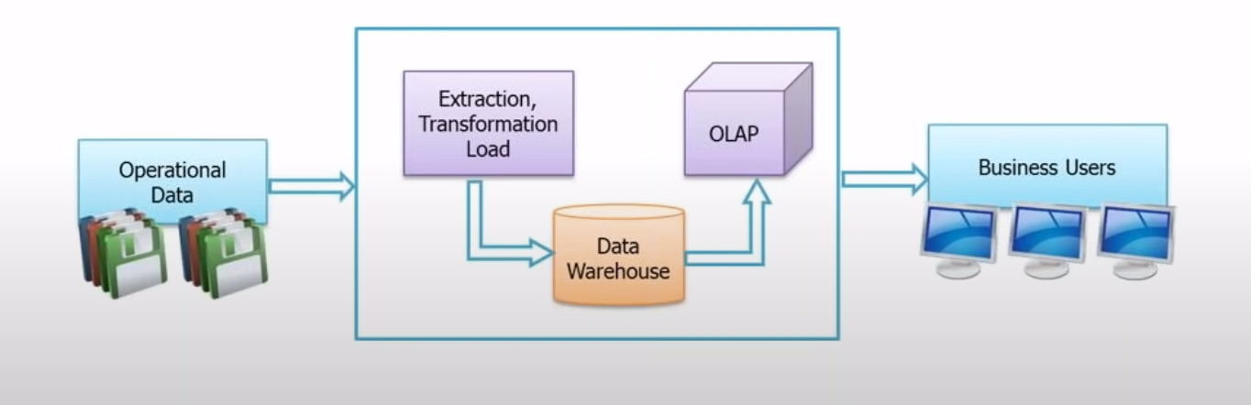
What is a Data Warehouse?
A central location where transformed data from multiple sources (DBs) are stored.
Data Warehouse is maintained separately from an organization’s operational database.
End users access DW whenever any information is needed.
Note that a Data Warehouse is not loaded every time new data is added to database. Generally, the loading process occurs automatically once per day during the night.

Slide 7
Motivations and Characteristics

Slide 8
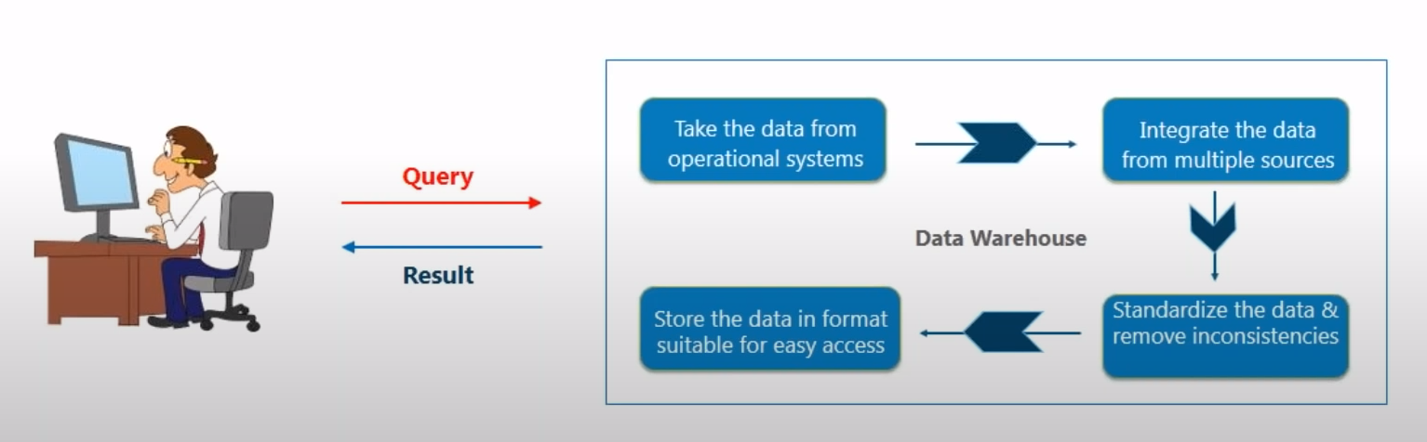
Advantages of a Data Warehouse
A Data Warehouse can answer strategic and tactical Business questions.
Data Warehouse is fast and accurate in responding to queries.
Note that a Data Warehouse is not a product that a company can purchase. It needs to be designed and implemented according to the company business requirements.

Slide 9
Decision Making Hierarchy
Decision making hierarchy
Typical decisions
Identify new markets, choose store locations
Choose suppliers, forecast sales
Resolve order delays, schedule employees
Notes:
Lower-level management deals with short-term problems related to individual transactions. Periodic summaries of operational databases and exception reports assist operational management. Middle management relies on summarized data that are integrated across operational databases. Middle management may want to integrate data across different departments, manufacturing plants, and retail stores. Top management relies on the results of middle management analysis and external data sources. Top management needs to integrate data so that customers, products, suppliers, and other important entities can be tracked across the entire organization. In addition, external data must be summarized and then integrated with internal data.
Operational databases serve lower level decision making. In the early days of relational databases, it was assumed that operational databases would also support higher levels of decision making.

Slide 10
Technology and Deployment Limitations
Why Databases are not suitable for carrying BI tasks?
DB cannot be integrated with other transaction DB and other external sources.
Using the same DB for transaction processing and BI tasks results in high workload for DB and lead to performance drop.
DB does not offer the features requested from Datawarehouse, e.g., summary data.
Data warehouse technology and deployments
Performance limitations
Lack of integration
Missing DBMS features
Notes:
The limitations were a combination of inadequacy of database technology and deployment limitations.
Missing features for summary data
Storage and optimization techniques for summary queries
Data modeling approaches
Support for precomputed query results
Support for different business analyst query tools
Performance limitation
Performance problems with a separate database for both transaction processing and business intelligence decision making
Never solved. Use a separate database
Lack of integration
Most important issue;
Management issue
Lack of integration with transaction databases and external data sources
Add value: integrate, standardize, clean, and summarize both internal and external data sources
Initially separate companies developed technology independent of relational databases
Relational database vendors did not focus on relational database technology extensions until late 1990s

Slide 11
Data Warehouse Definition
DW is an essential part of infrastructure for business intelligence
DW is logically centralized repository for decision making
Populated from operational databases and external data sources
Integrated and transformed data
Optimized for reporting and periodic integration
Notes:
Definition:
- Central repository: populated from operational databases and external data sources
- Many transformations to clean, standardize, and integrate
- Summarized: no need to identify individual transactions although transaction details
may be useful for flexible data analysis; summary data for optimizing reporting

Slide 12
Data Warehouse Characteristics
“A Data Warehouse is a subject-oriented, integrated, time-variant and nonvolatile collection of data in support of management’s decision-making process.” Bill Inmon, Father of Data Warehousing
Subject-oriented: Organized around business entities (e.g., customers, products, and employees) rather than business processes
Integrated: many transformations to unify source data from independent data sources (units of measure, data formats, naming conventions)
Time-variant: historical data (time stamped); snapshots of business processes captured at different points in time
Nonvolatile: existing data is not changed; new data are appended periodically; warehouse data may be archived after its usefulness declines
Notes:
Characteristics
- Subject-oriented: Organized around business entities (e.g., customers, products, and employees)
rather than business processes
- Integrated: many transformations to unify source data from independent data sources (units
of measure, data formats, naming conventions)
- Time-variant: historical data (time stamped); snapshots of business processes captured
at different points in time
- Nonvolatile: new data are appended periodically; existing data is not changed; warehouse data
may be archived after its usefulness declines

Slide 13
Comparison of Processing Environments
Transaction processing
Business intelligence processing
Primary data from transactions
Daily operations and short term decisions
Transformed secondary data
Medium and long-term decisions
Notes:
Transaction processing:
- Operational databases: for daily business
- Decisions: involve details of products, customers, shipments, manufacturing such as fulfill orders, resolve complaints, provide staffing
Business intelligence:
Integrated and standardized data: difficult to directly use operational data
Substantial processing for transformations and integration
Value for decision making results from standardizing and integrating data across organizational units and external sources
Decisions: broad view of customers, products, production, marketing for capacity planning, store locations, new lines of business, …

Slide 14
Data Comparison
Characteristic | Operational Database | Data Warehouse
Currency | Contains current data | Contains historical data
Details level | Individual | Individual and summary
Orientation | Process-oriented | Subject-oriented
Records per request | Few | Thousands
Normalization level | Mostly normalized | Normalization relaxed
Update level | Highly volatile | Mostly refreshed (nonvolatile)
Data model | Relational | Relational (star schemas) and multidimensional (data cubes)
Notes:
Operational database vs. Data warehouse
- Currency: age of data
- Historical: completed transactions; secondary data
- Detail level: DW do not need to identify individual transactions although details can be stored; typically both detailed and summary data are stored in a data warehouse
- Number of records processed (per request): operational database query typically returns few records; DW query may summarize thousands of records
- Normalization: normalization not important for DW because of lack of update
- Data model: new data model for DWs although relational implementation is generally used to implement the new data model
- Update level: nonvolatile, i.e., new data are appended periodically; existing data is not changed; warehouse data may be archived after its usefulness declines
- Star schemas with materialized views for summary data are used in relational DBMSs

Slide 15
Schema Comparison
Operational database
Data warehouse
Notes:
Crow’s foot ERD notation
Small diagram of order entry database and sales star schema
Small ERD of order entry database with customer, order, employee, product, and M-N relationship between product and order; designed for order processing
More complex schema patterns for operational databases
Order contains header (order) and detail lines (Contains M-N relationship or a associative table)
Star Schema with dimension tables (item, store, customer, and timedim) and fact table (sales); designed for business intelligence reporting
Sales flattened just for order details (sales of individual items)
Data integration: data moved from operational database to data warehouse after completion of transactions along with substantial amount of transformations (standardization, integration, consistency checking, completeness checking, …)

Slide 16
Data Warehouse Architectures

Slide 17
Architecture Issues
The choice of the architecture for a DW is decided by the organization (the company), this choice is not limited by the technology
The choice of DW architecture depends on Data warehouse scope
Number of data sources
Number of organizational units
Notes:
Data warehouse scope (Project scope):
Number of data sources
Number of organizational units
Integration level
Coordination and cooperation among business units
Find common entities
Enforce standards: units of measure, naming conventions
Reconcile differences such as revenue and cost recognition
Sometimes modify source systems

Slide 18
Architecture Issues
The choice of DW architecture depends on the integration level
Coordination and cooperation among business units
Find common entities
Enforce standards: units of measure, naming conventions
Reconcile differences such as revenue and cost recognition
Sometimes modify source systems
Notes:
Data warehouse scope (Project scope):
Number of data sources
Number of organizational units
Integration level
Coordination and cooperation among business units
Find common entities
Enforce standards: units of measure, naming conventions
Reconcile differences such as revenue and cost recognition
Sometimes modify source systems

Slide 19
Architecture Choices
Top Down
Bottom Up
Enterprise data warehouse
Independent data marts
Higher integration levels
Larger project scope
Lower integration levels
Smaller project scope
Logically centralized
Logically decentralized
Notes:
Top down
Data warehouse approach
More project risk
Higher integration levels
More business value over time
Extreme: one DW for entire organization
Bottom up
Data mart approach
Less project risk
Driven by compelling decision making needs
Less business value over time
May be difficult to increase scope by integrating data marts

Slide 20
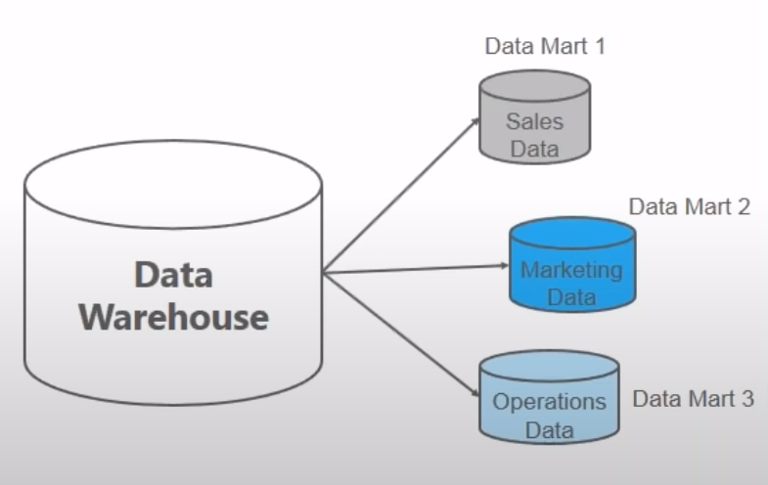
Data Mart
Data mart is a smaller version of the Data Warehouse which deals with a single subject area.
Since Data marts focus on one area, they collect data from a limited number of sources
The time taken to build a Data Mart is very less compared to the time taken to build a Data Warehouse
Data Warehouses | Data Marts
Enterprise-wide data | Department-wide data
Multiple subject areas | Single subject area
Multiple data sources | Limited data sources
Occupy large memory | Occupy limited memory
Longer time to implement | Shorter time to implement

Slide 21
Top-Down Architecture
Notes:
The three-tier architecture is sometimes augmented with a staging area to support the data transformation process.
The staging area provides temporary storage of transformed data before loading into the data warehouse.
The staging area is particularly useful for data warehouses with a large number of operational databases and external data sources requiring complex data transformations.
EDM: enterprise data model
Also known as enterprise data warehouse architecture

Slide 22
Bottom-up Architecture
Notes:
Also known as independent data mart architecture
No centralized data warehouse
Data marts: small data warehouses oriented towards individual user departments
Easier to cost justify (at least in the short run) than a larger data warehouse
Data marts may eventually evolve into a data warehouse
Data marts may cooperate to provide data to other data marts: data mart bus approach
Controversial architecture:
- Many claim that the long term benefits are lost with a bottom-up approach
- Many claim that data marts must be re-implemented as centralized data warehouse
(more costly over the long term)

Slide 23
Federated Architecture
Notes:
For highly decentralized or independent organizations, the federated data warehouse architecture provides another compromise approach.
As depicted in this diagram, the federated data warehouse approach supports two levels of data warehouses.
Each organization independently maintains one or more data warehouses using any of the architectures.
To provide inter-organizational sharing, each organization contributes to the federated data warehouse. Typically, another layer of data integration and a query portal support data sharing in the federated data warehouse. Depending on the environment, participation can be voluntary or compulsory (typically required by government agencies). Some users of a federated data warehouse may be external stakeholders, not members of participating organizations.
A possible use case is a consortium formed by several companies can adopt the Federated Architecture

Slide 24
Federated Architecture
For highly decentralized or independent organizations, the federated data warehouse architecture provides another compromise approach.
As depicted in this diagram, the federated data warehouse approach supports two levels of data warehouses.
Each organization independently maintains one or more data warehouses using any of the architectures.
To provide inter-organizational sharing, each organization contributes to the federated data warehouse.

Slide 25
Federated Architecture
Typically, another layer of data integration and a query portal support data sharing in the federated data warehouse.
Depending on the environment, participation can be voluntary or compulsory (typically required by government agencies).
Some users of a federated data warehouse may be external stakeholders, not members of participating organizations.
A possible use case is a consortium formed by several companies can adopt the Federated Architecture
Notes:
For highly decentralized or independent organizations, the federated data warehouse architecture provides another compromise approach.
As depicted in this diagram, the federated data warehouse approach supports two levels of data warehouses.
Each organization independently maintains one or more data warehouses using any of the architectures.
To provide inter-organizational sharing, each organization contributes to the federated data warehouse. Typically, another layer of data integration and a query portal support data sharing in the federated data warehouse. Depending on the environment, participation can be voluntary or compulsory (typically required by government agencies). Some users of a federated data warehouse may be external stakeholders, not members of participating organizations.
A possible use case is a consortium formed by several companies can adopt the Federated Architecture

Slide 26
Architecture Selection Factors
Learning effects
Project risk
Intangible business value
Strategic view of information technology
Level of sponsorship
Information independence
Task routineness
Notes:
Project risks
Difficulty to obtain cooperation among disparate groups
Unforeseen difficulties when discovering data quality problems
Intangible Business value
Intangible: difficult to quantify
More value from integrating larger part of enterprise
More risk from difficulty to obtain cooperation
Intangible benefits difficult to quantify
Funding difficulties
Difficult to fund a high cost, high risk project
More corporate involvement for projects with wide scope
Data mart approach is easier to obtain funding

Slide 27
Employment Opportunities

Slide 28
Employment Opportunities
Recommend technology solutions
Define user interfaces
DW Manager
Design, develop, and maintain data warehouses
Ensure conformance to enterprise standards
Collaborate with business analysts and DW managers
Develop and implement data integration procedures
DW Analyst
BI Analyst
Develop data analysis and reporting solutions
Mine and analyze data from multiple sources
Communicate results to management
Prepare data (reduction and missing values)
Data Analyst
Document data elements
Use reporting tools
Collaborate with business analysts and data architects
Develop data extraction procedures
Notes:
Source: Robert Half Salary Guide 2013
Data warehouse positions
Data warehouse analyst (http://blog.rht.com/data-warehouse-analyst-bridging-present-future)
Data warehouse manager (http://blog.rht.com/data-warehouse-manager-enabling-business-intelligence)
Common skills
Relational database background
Typically university degree
3 to 5 years work experience in databases and/or data warehouses
DW analyst qualifications
Excellent research, analysis, and problem-solving skills
Strong communication and listening skills
Experience with data modeling and architecture
DW manager qualifications
Excellent analytical abilities
Project management experience managing technical personnel
Five or more years of experience in a data warehousing environment
Proficiency in data warehousing tools
BI analyst skills:
Background in database technology
Analytical and reporting tools
Written and oral communication
BI analyst education
Computer science, information systems, or engineering
Several years of experience with database queries and data cube technology
Data analyst skills
Analytical, quantitative, and problem solving
Relational database theory and practice
Written and oral communication skills
Data analyst education
Bachelors in computer science, information systems, or related discipline
Several years experience with a major DBMS product

Slide 29
Skill-Position Mapping
Competency | Position
 | DW Manager | DW Analyst | BI Analyst
Communication | ▄ | █ | █
Data cube tools | ▄ | █ | █
Dashboards |  | ▄ | █
Data mining | ▄ |  | █
Data integration tools | █ | █
DW schema design | █ | ▄
Performance analysis | █
Quantitative modeling |  |  | █
SQL extensions | █ | █ | ▄
Notes:
Did not show data analyst due to large overlap with BI analyst
Skill acquisition
Degree
Certification
Experience

Slide 30
Competency Acquisition
Courses/
Degrees
Internship
Certification
Experience
Career Progression
Notes:
Can be overlap about the methods to acquire competencies
Courses can be in minor, electives, and major

Slide 31
Salary Percentiles (USA) in 2018
Job Title | 25th Percentile | Midpoint | 75th Percentile
DB manager | $107,000 | $127,000 | $152,250
DB developer | $97,950 | $116,000 | $139,000
Data analyst | $81,000 | $96,000 | $115,000
DW manager/architect | $110,00 | $130,000 | $156,000
DW analyst | $75,250 | $93,500 | $117,000
BI analyst | $83,750 | $104,000 | $130,250
Notes:
Salary percentiles from Robert Half Salary Survey
https://www.roberthalf.com/sites/default/files/documents/2018_salary_guide_NA_technology_1.pdf
Percentile guide:
25%: less experience than typical, skills may require development
50% (midpoint): average experience, necessary skills to meet job requirements
75%: more experience than typical, strong skill set with specialized skills

